Slide 1
WEEK 3
Internship under dr gs javed sir
INTERN NAME - AFZAL MALIK
College/UNIVERSITY – ZAKIR HUSAIN COLLEGE OF ENGG. & TECH.
ALIGARH MUSLIM UNIVERSITY
COURSE- BACHELOR OF TECHNOLOGY (ELECTRONICS ENGG.)
YEAR – SECOND

Slide 2
WEEK 3 INTERNSHIP TASK
Differential Pair simulation
Current Mirror simulation
NOTE : DESIGN CONSTRAINT IS TO USE UNIT DEVICES
SOFTWARE USED : LT Spice

Slide 3
SIMPLE CURRENT MIRROR
DESIGN AND SIMULATION using lt spice
Model file : 180n
SPECIFICATIONS
Iref=50uA is used for Id(M2) =500uA

Slide 4
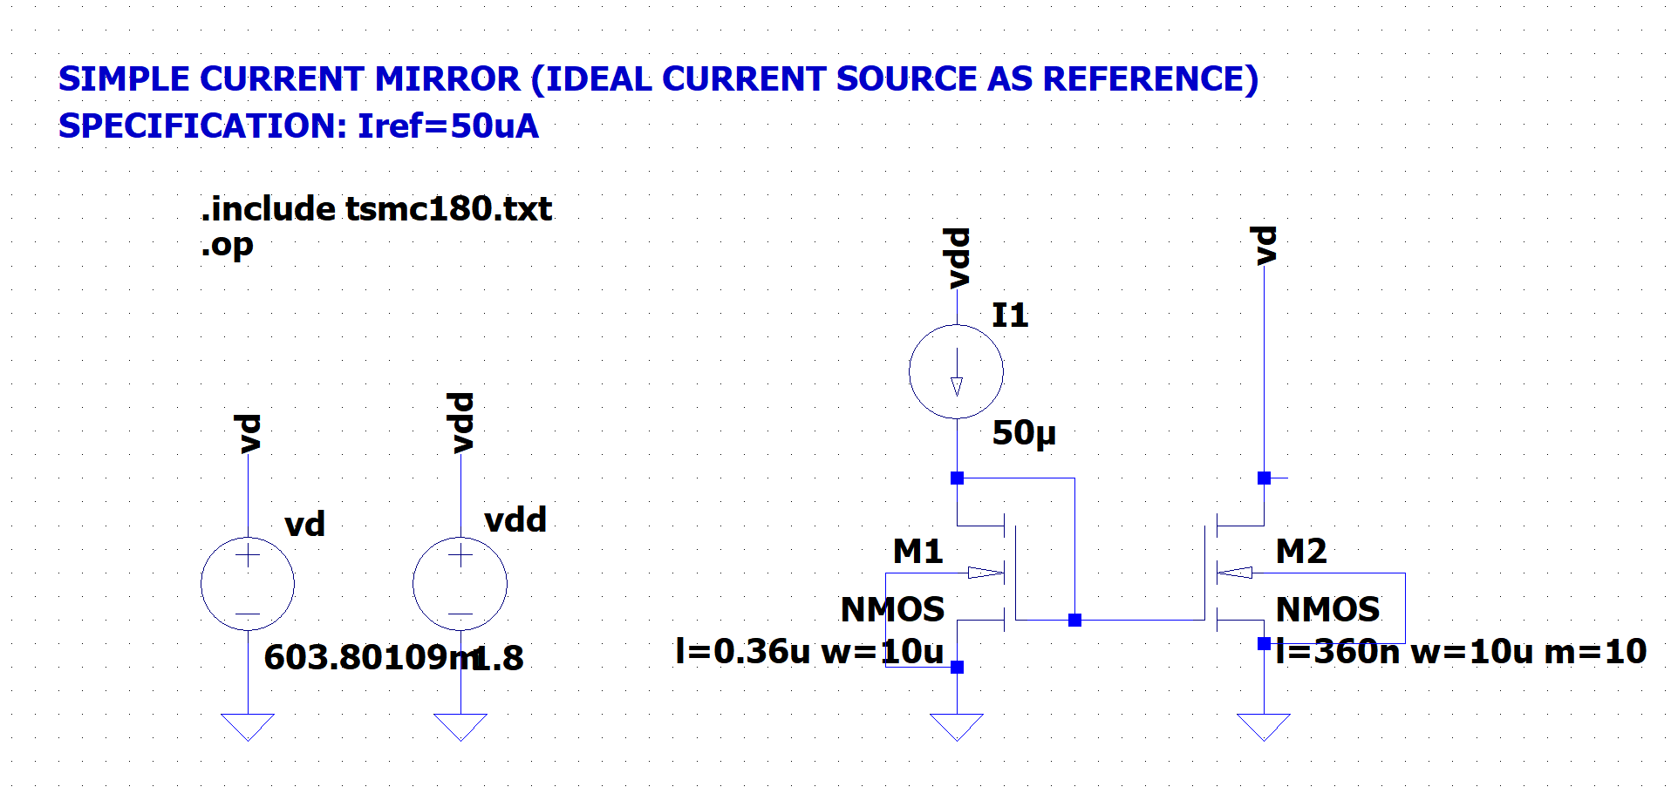
SCHEMATIC

Slide 5
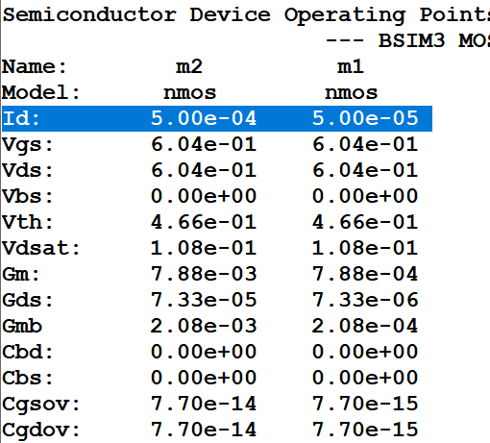
SPICE ERROR LOG
SUMMARY
SPECIFICATION | SIMULATION RESULTS
Iref= Id(M1) = 50uA | Iref= Id(M1) = 50uA
Id(M2) = 500uA | Id(M2) = 500uA

Slide 6
SIMPLE CURRENT MIRROR
DESIGN AND SIMULATION using lt spice
Model file : 180n
SPECIFICATIONS
Iref=50uA is used for Id(M2) =500uA
Note: Ideal Current Source is replaced by Diode connected PMOS

Slide 7
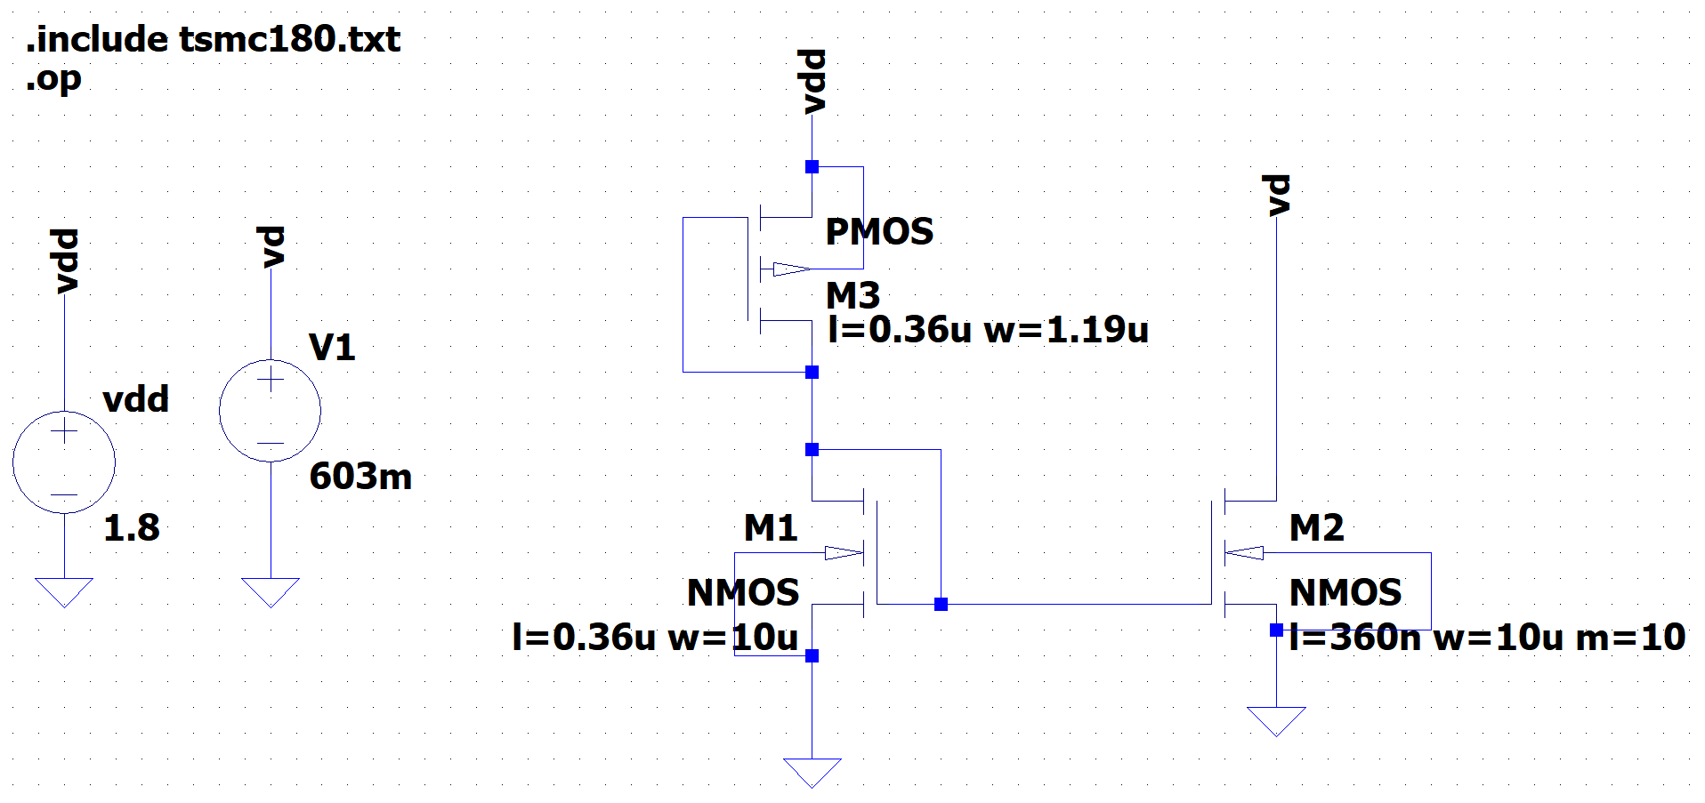
SCHEMATIC

Slide 8
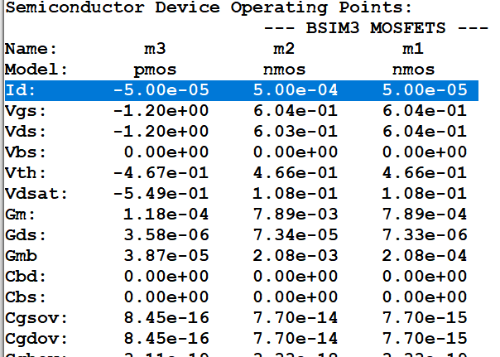
SPICE ERROR LOG
SUMMARY
SPECIFICATION | SIMULATION RESULTS
Iref= Id(M1) = 50uA Id(M3) = 50uA | Iref= Id(M1) = 50uA Id(M3) = 50uA
Id(M2) = 500uA | Id(M2) = 500uA

Slide 9
CASCODE CURRENT MIRROR
DESIGN AND SIMULATION using lt spice
Model file : 180n
SPECIFICATIONS
Iref=50uA is used for Id(M2) =500uA

Slide 10
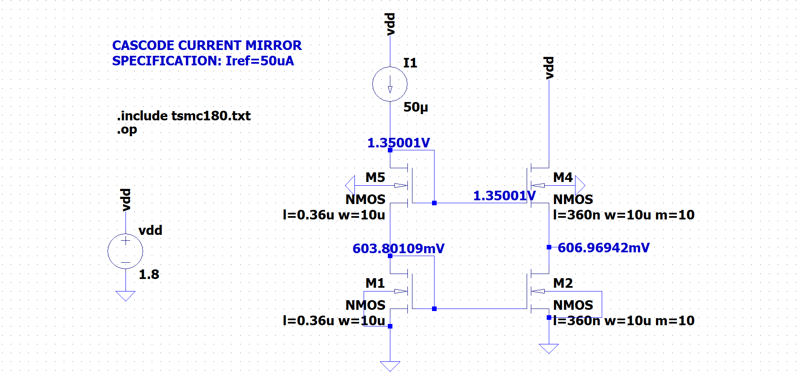
SCHEMATIC

Slide 11
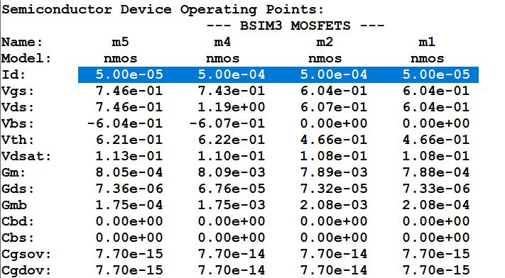
SPICE ERROR LOG
SUMMARY
SPECIFICATION | SIMULATION RESULTS
Iref= 50uA | Iref= 50uA
Id(M4) = 500uA Id(M3) = 500uA | Id(M4) = 500uA Id(M3) = 500uA

Slide 12
DIFFERENTIAL PAIR
DESIGN AND SIMULATION using lt spice
Model file : 180n
SPECIFICATIONS
GBW= 1GHz
Gain = 10 at 100 MHz frequency

Slide 13
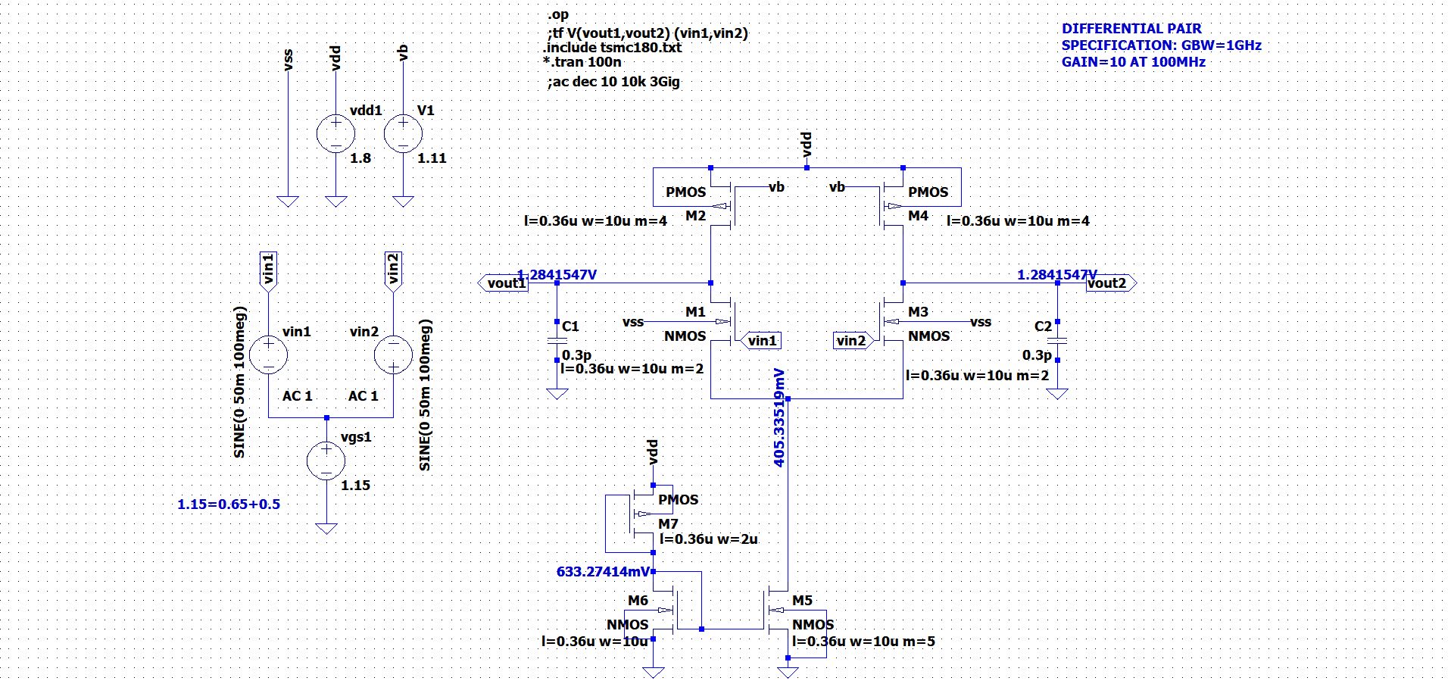
SCHEMATIC

Slide 14
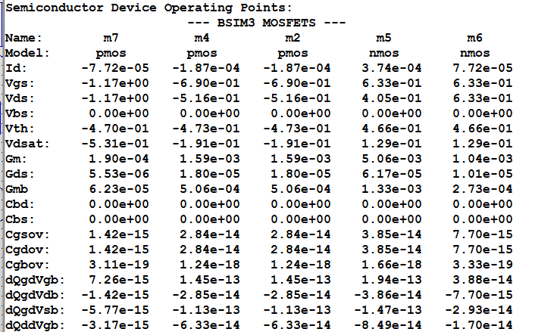
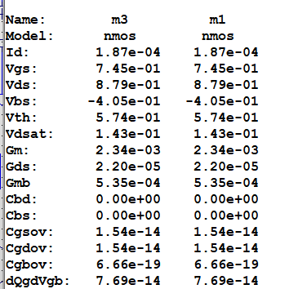
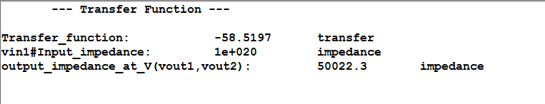
SPICE ERROR LOG

Slide 15
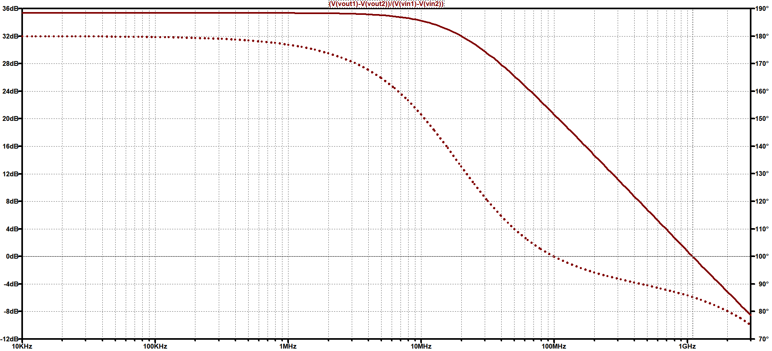
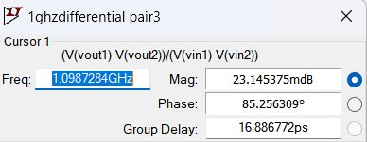
FREQUENCY RESPONSE
GBW=1.0987GHz

Slide 16
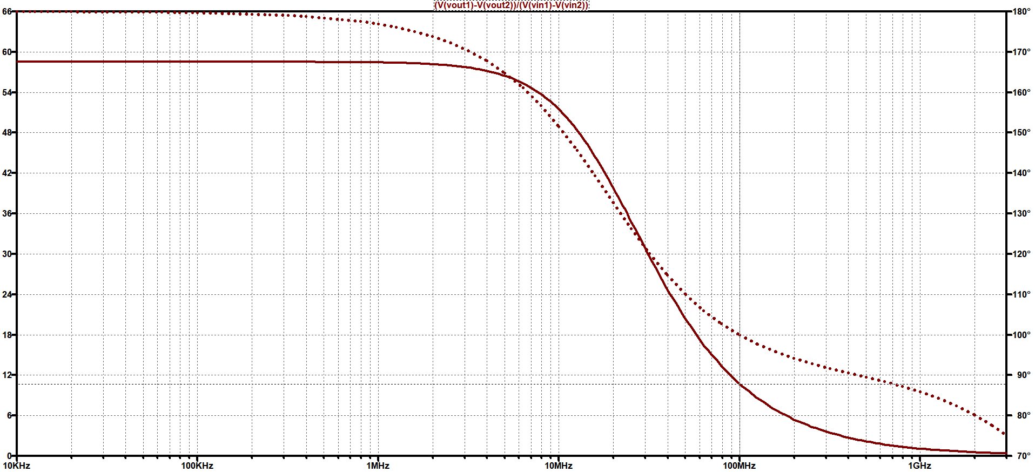
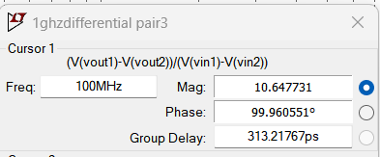
FREQUENCY RESPONSE
AT 100MHz Gain = 10.647

Slide 17
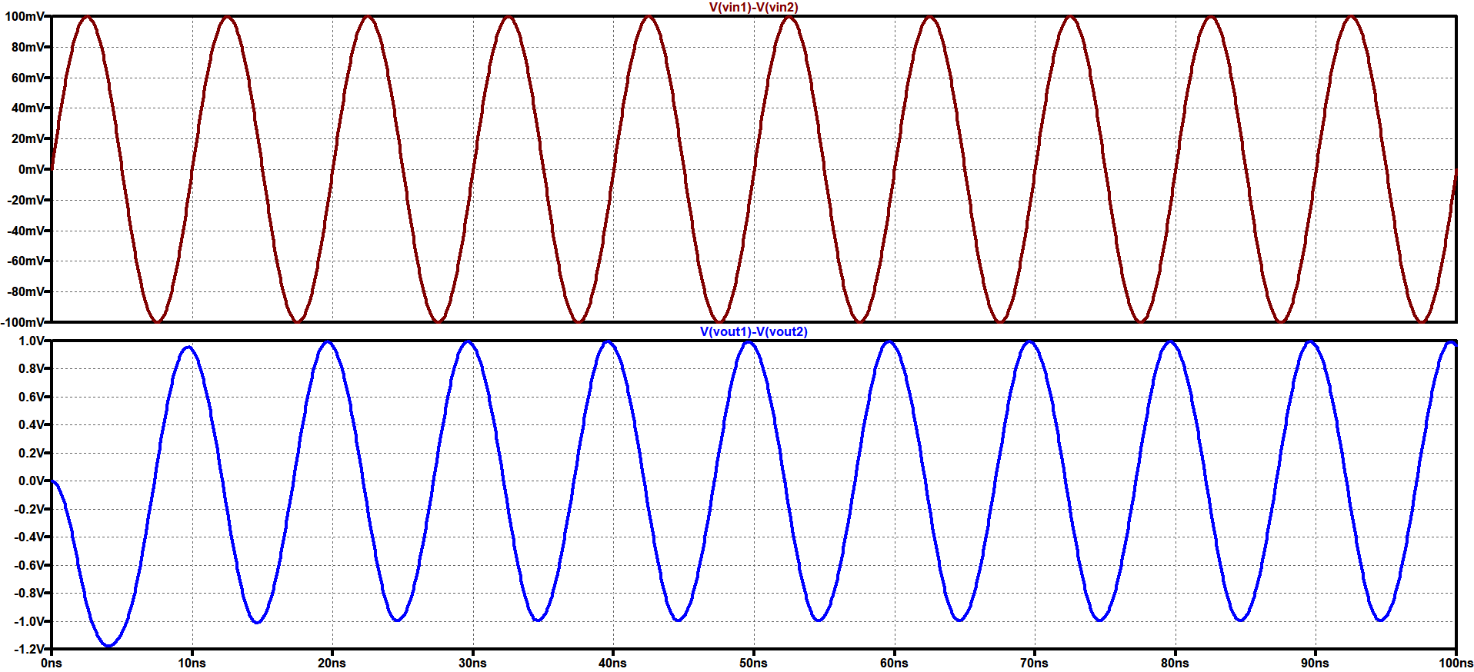
TRANSIENT ANALYSIS
If 10mV signal is given at 100MHz then we can observe from here Gain is nearly 10

Slide 18
SUMMARY
SPECIFICATION | SIMULATION RESULTS
GBW=1GHz | GBW=1.09GHz
Gain 10 at 100MHz | Gain 10.647 at 100MHz

Slide 19
THANK YOU

